Slide 1
Recurrent Neural Networks
Varol Kayhan, PhD

Slide 2
Recurrent Neural Networks (RNN)
Regular neural networks analyze “cross-sectional” data
No “time” dimension
RNNs can look at both:
Current state (i.e., cross-section)
Recent past
Advantage: information can “persist” in the neural network
Similar to “watching a movie”

Slide 3
Recurrent Neural Networks (RNN)
Helps analyze "time-series" data sets
Can handle sequences of data!
Example applications:
Stock prices?!
What you'll type next
Car trajectory in self-driving
Machine translation
Speech-to-text (i.e., Alexa, Google Assistant)
Audio and songs

Slide 4
Note: watching a movie!
How would you organize the data set?
Inputs: plot highlights at certain “time steps”
Target: “feel good movie” or not
Movie ID | T.S.1 | T.S.2 | … | … | … | T.S.(N) | Target
1 | 0.31 | 0.44 | … | … | … | … | 1
2 | 1.34 | 1.74 | … | … | … | … | 0
… | … | … | … | … | … | … | …
… | … | … | … | … | … | … | …
(M) | 0.65 | 1.55 | … | … | … | … | 0

Slide 5
Note: watching a movie!
I SHOULD process the values “sequentially” (not “cross-sectionally”)
Example, consider the first movie:
Movie ID | T.S.1 | T.S.2 | … | … | … | T.S.(N) | Target
1 | 0.31 | 0.44 | … | … | … | … | 1
Cross-sectional NN
Sequential NN
Input
Hidden
Output
Input
Hidden
Output
T.S.3 = …
T.S.1 = 0.31
T.S.2 = 0.44
…
T.S.1 = 0.31
T.S.(N) = …

Slide 6
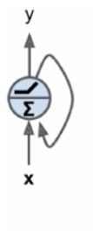
Recurrent Neurons
We also need a mechanism to “remember past values” in a sequence
Neurons have connections from past (i.e., previous) observations
Neurons receive an input, generate an output. This output is sent back (and processed together with next input)
Recurrent neural networks are “feedforward” networks with backward connections!!!

Slide 7
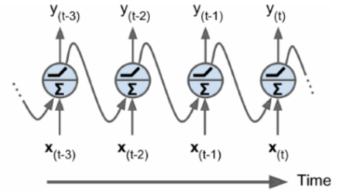
Recurrent Neurons
“Unroll the network through time”:
All four neurons are the same neuron "unrolled through time"

Slide 8
Recurrent Neurons
Temp readings: (each row represents one day)
[[78, 80, 84, 87, 90, …] [74, 75, 76, 77, 78, …
79.4
81.1
84.3
0
All four neurons are the same neuron "unrolled through time"
79.4
81.1
84.3
78
80
84
87

Slide 9
Recurrent Neurons
If there are multiple neurons in the hidden layer:
y₀₁
y₀₃
y₁₁
y₁₂
y₁₃
y₀₂
etc.
w
w
w
w
w
w
w
w
w
x₀
x₁
y₀₃
y₀₁
y₀₂
T₀
T₁

Slide 10
Memory Cells
A neuron has a “memory” (so, we call it a “memory cell”)
A neuron’s one "input" comes from the previous time step
A single recurrent neuron can learn about 10 time-steps
More advanced recurrent neurons can learn longer

Slide 11
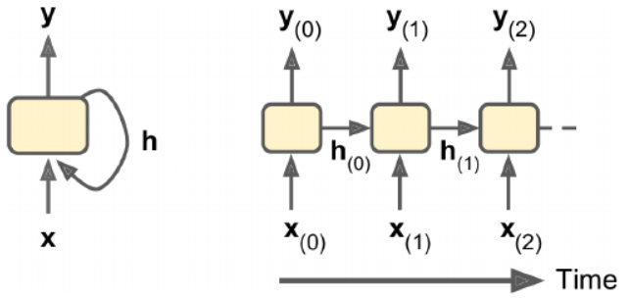
Memory Cells
A cell's state is called h (for hidden)
y (output) is a function of h_{t-1} (previous state) and x_{t}

Slide 12
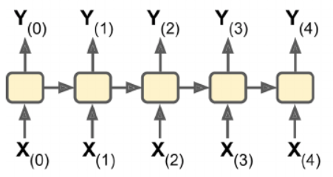
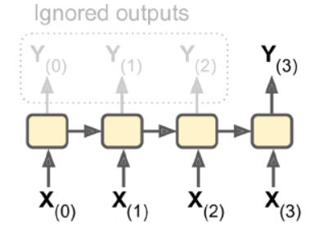
Inputs and Outputs
There are different types of RNNs based on inputs and outputs
1) Predict a sequence
Input: a sequence of values
Output: a sequence of values
E.g., feed stock prices, predict stock prices shifted by one day
2) Predict a single value
Input: a sequence of values
Output: one value
E.g., feed a sequence of words, predict sentiment

Slide 13
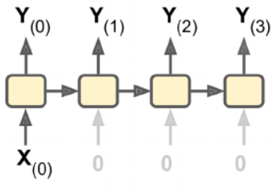
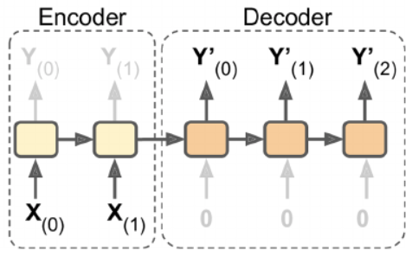
Inputs and Outputs
3) Predict a sequence based on a single value
Input: one value
Output: sequence of values
E.g., feed an image, predict its caption
4) Predict a sequence based on a sequence
Input: sequence of values
Output: sequence of values
E.g., translation (the whole statement is used to generate Y' values (translated statement))

Slide 14
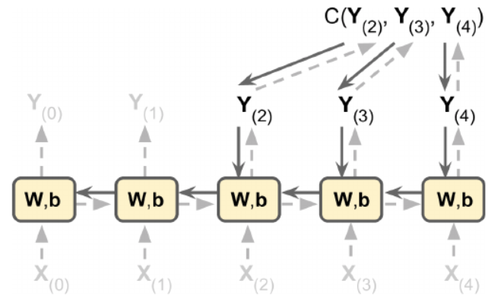
Training RNNs
Backpropagation through time (BPTT)
Perform first pass through unrolled network
Evaluate the output sequence using a cost function
Back propagate the gradients through unrolled network
Update parameters
Dashed lines show first pass
Solid lines show backprop. only on Y₂, Y₃, and Y₄

Slide 15
Forecasting a Time Series
Two kinds of time series:
Univariate (a single variable per time step)
Average temperature per day for 30 days
Multivariate (two or more variables per time step)
Average temperature per day, and average humidity per day for 30 days
Goal: predict next value (either a single value or sequence)
RNNs can perform both tasks

Slide 16
Sequence to vector example:
Input: (daily temp values at 8am, 10am, 12pm, 2pm, 4pm)
[[78, 80, 84, 87, 90] [74, 75, 76, 77, 78] […]]
Target: (daily temp values at 6pm, 8pm)
[[88, 87] [77, 77] […]]

Slide 17
Sequence to sequence example
Input: (sliding window: 8am, 10am, 12pm, 2pm, 4pm) [[78, 80, 84, 87, 90]
[[78, 80] [80, 84] [84, 87] […]]
Target: (sliding window)
[[84, 87] [87, 90] […]]
You can ignore the intermediate predictions and focus on last 2 only (6pm, 8pm)
Tricky to do:
Requires to re-transform the training and target values
Requires TimeDistributed() wrapper for Dense() if the last layer is dense

Slide 18
Sequence to scale
Predict one value only.
Input: (daily temp values at 8am, 10am, 12pm, 2pm, 4pm)
[[78, 80, 84, 87, 90] [74, 75, 76, 77, 78] […]]
Target: (daily temp values at 6pm)
[[88] [77] […]]

Slide 19
Sequence to scale
WHAT IF YOU HAVE UNEQUAL LENGTH SEQUENCES???
Input: (daily temp values)
[[78, 80, 84, 87, 90] [74, 75, 76, 77] […]]
Target: (daily temp values at 6pm)
[[88] [77] […]]
ZERO–PADDING
[[78, 80, 84, 87, 90] [74, 75, 76, 77, 0] […]]
How do you account for zero-padding: at the input layer
model = tf.keras.models.Sequential([
tf.keras.layers.Masking(mask_value=0, input_shape=[n_steps, n_inputs]),
tf.keras.layers.LSTM(20),
(etc.)

Slide 20
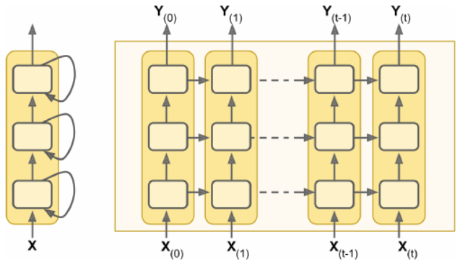
Deep RNN
Stack multiple layers

Slide 21
Issues with RNNs
Suffer from vanishing/exploding gradients (so are unstable!)
Use:
Parameter initialization
Faster optimizers
Dropout layer
Do not use:
Non-saturating activation functions (ReLu) – make things worse
Batch normalization – doesn’t work
Take a very long time to train!
Use shorter input sequences (But, what if you lose the pattern?)
Memory of the first inputs fades away
A long RNN contains no trace of first inputs

Slide 22
LSTM Cells
Long Short-Term Memory cells
Remember the first inputs!
Can detect long-term dependencies
Forget gates remove irrelevant information from "long-term" state
Input gates add new memories to the long-term state

Slide 23
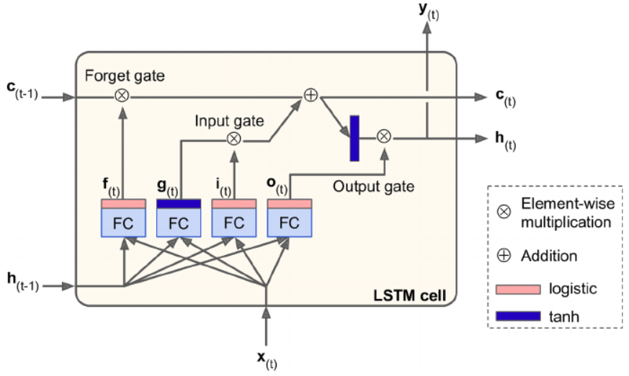
LSTM Cells
Controls what to forget from memory
Controls what to add to memory
Controls what to output for short-term
Long-term state
Logistic outputs either 1 or 0. Since multiplication, it either generates 1 or 0, which controls the gates (open, vs. close)
Short-term state
This is the basic cell we saw in RNN
FC: fully connected layer

Slide 24
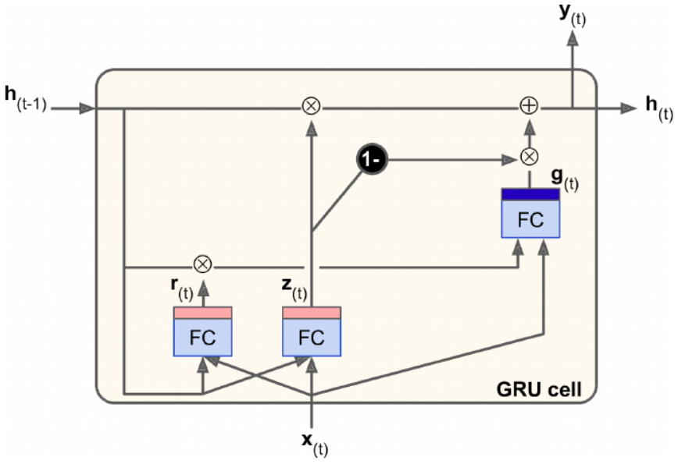
GRU Cells
Gated Recurrent Unit
A variant of LSTM cell
Much simpler than LSTM, but performs as well
Forget gate closes the input gate (can't add anything new without removing memory)

Slide 25
Convolution Layer (1D)
LSTM and GRU cells are still limited:
Have a relatively short-term memory
Have a hard time learning long-term patterns
Take a long time to process
Solution: Conv1D layer
Similar to image processing
Convolution layer on a single dimension (which is the sequence)

Slide 26
Convolution Layer (1D)
Uses a kernel so extract information from a sequence
Move (by stride value)
kernel
1 | 2 | 3 | 5 | 8 | 13 | 21 | 34 | … | …
Extract value

Slide 27
Convolution Layer (1D)
Use more than one kernel
Each kernel learns a pattern from a short sequence
As a result, reduce the sequence to a shorter sequence with learned patterns
Final step: feed this short sequence to a LSTM/GRU layer (to detect the overall pattern)

Slide 28
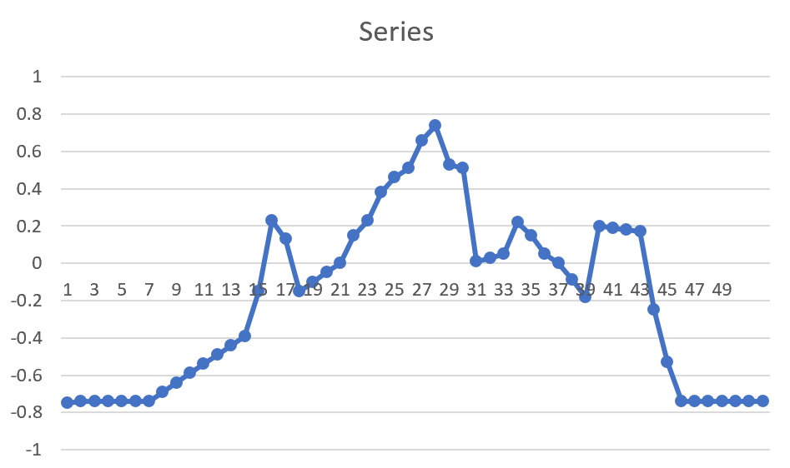
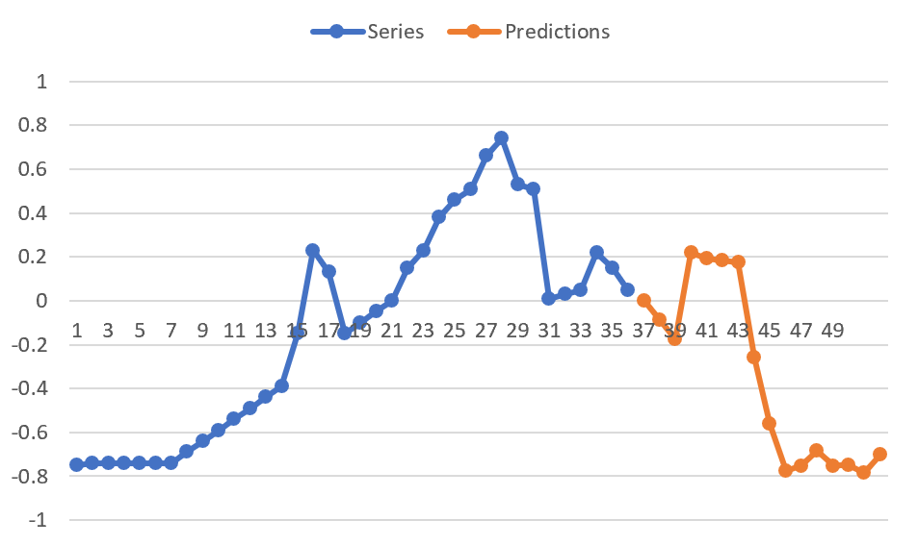
How Can We Use RNNs?
Time Series Prediction

Slide 29
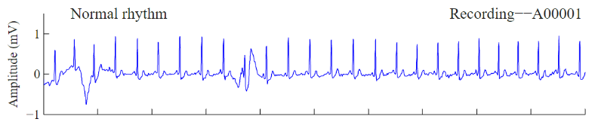
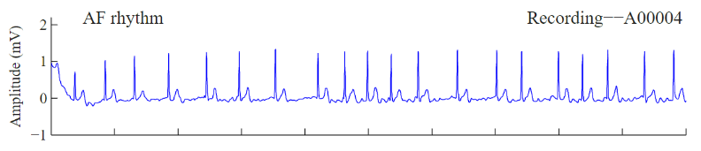
How Can We Use RNNs?
Sequence classification (e.g., Atrial Fibrillation (AF))
INPUT | TARGET
 | Normal
 | AF
(etc.) | (etc.)
(etc.) | (etc.)

Slide 30
How Can We Use RNNs?
Natural Language Processing (NLP):
Auto summarization
Predicting the next word/phrase
Parsing
Sentiment analysis
Translation

Slide 31
Summary
RNNs can do time-series and sequence analysis!
Needs a new way of thinking about data prep. and data analysis

